Slide 1
Latin and Greek Roots
Review of some Latin and Greek roots beginning with I – L
Notes:
Ech – sound
Ego – self
Eme – vomit
Endo – inside/within
Epi = upon
Erg – work
Ethn- race/people
Exo – outside
Fac – do or make
Fall – false
Fend – strike
-fer – bear or carry
Fides – truth trust
Fund - bottom

Slide 2
Icthy -
fish
Ichthyosaur
Ichthyology
Icthys
Notes:
Ech – sound
Ego – self
Eme – vomit
Endo – inside/within
Epi = upon
Erg – work
Ethn- race/people
Exo – outside
Fac – do or make
Fall – false
Fend – strike
-fer – bear or carry
Fides – truth trust
Fund - bottom

Slide 3
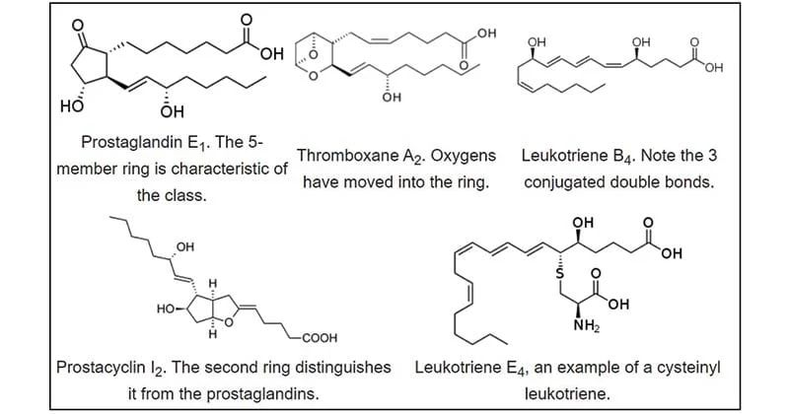
Icos -
twenty
Icosahedron
eicosanoids
Notes:
Ech – sound
Ego – self
Eme – vomit
Endo – inside/within
Epi = upon
Erg – work
Ethn- race/people
Exo – outside
Fac – do or make
Fall – false
Fend – strike
-fer – bear or carry
Fides – truth trust
Fund - bottom

Slide 4
Ideo -
Idea - thought
Idea
Ideologue
Ideology
Ideogram
Ideation
Notes:
Ech – sound
Ego – self
Eme – vomit
Endo – inside/within
Epi = upon
Erg – work
Ethn- race/people
Exo – outside
Fac – do or make
Fall – false
Fend – strike
-fer – bear or carry
Fides – truth trust
Fund - bottom

Slide 5
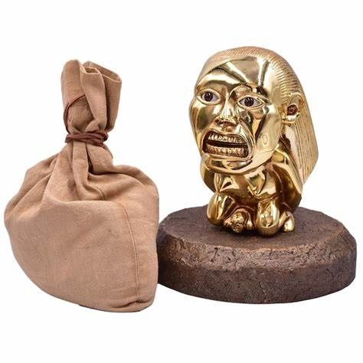
Idol -
Form or shape – from eidos
Idol
Idolize
Idolatry
Idolatrous
Notes:
Ech – sound
Ego – self
Eme – vomit
Endo – inside/within
Epi = upon
Erg – work
Ethn- race/people
Exo – outside
Fac – do or make
Fall – false
Fend – strike
-fer – bear or carry
Fides – truth trust
Fund - bottom

Slide 6
Idi -
personal
Idiom
Idiosyncratic
Idiomatic
Idiocy
Notes:
Ech – sound
Ego – self
Eme – vomit
Endo – inside/within
Epi = upon
Erg – work
Ethn- race/people
Exo – outside
Fac – do or make
Fall – false
Fend – strike
-fer – bear or carry
Fides – truth trust
Fund - bottom

Slide 7
Igni-
fire
Igneous
Ignite
Ignition
Ignify
Notes:
Ech – sound
Ego – self
Eme – vomit
Endo – inside/within
Epi = upon
Erg – work
Ethn- race/people
Exo – outside
Fac – do or make
Fall – false
Fend – strike
-fer – bear or carry
Fides – truth trust
Fund - bottom

Slide 8
Im(n) -
in
Immigrate
Impound
Import
Incur Icthys
Notes:
Ech – sound
Ego – self
Eme – vomit
Endo – inside/within
Epi = upon
Erg – work
Ethn- race/people
Exo – outside
Fac – do or make
Fall – false
Fend – strike
-fer – bear or carry
Fides – truth trust
Fund - bottom

Slide 9
Im(n) -
not
Impossible
Immutable
Invisible
Inept
Notes:
Ech – sound
Ego – self
Eme – vomit
Endo – inside/within
Epi = upon
Erg – work
Ethn- race/people
Exo – outside
Fac – do or make
Fall – false
Fend – strike
-fer – bear or carry
Fides – truth trust
Fund - bottom

Slide 10
Insula -
island
Insulated
Insular
Peninsula
Insulin
Insulate
Notes:
Ech – sound
Ego – self
Eme – vomit
Endo – inside/within
Epi = upon
Erg – work
Ethn- race/people
Exo – outside
Fac – do or make
Fall – false
Fend – strike
-fer – bear or carry
Fides – truth trust
Fund - bottom

Slide 11
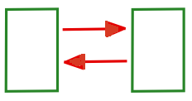
Inter -
between
Intermural
Interrelationships
Interaction
Intercoastal
Interchange
Notes:
Ech – sound
Ego – self
Eme – vomit
Endo – inside/within
Epi = upon
Erg – work
Ethn- race/people
Exo – outside
Fac – do or make
Fall – false
Fend – strike
-fer – bear or carry
Fides – truth trust
Fund - bottom

Slide 12
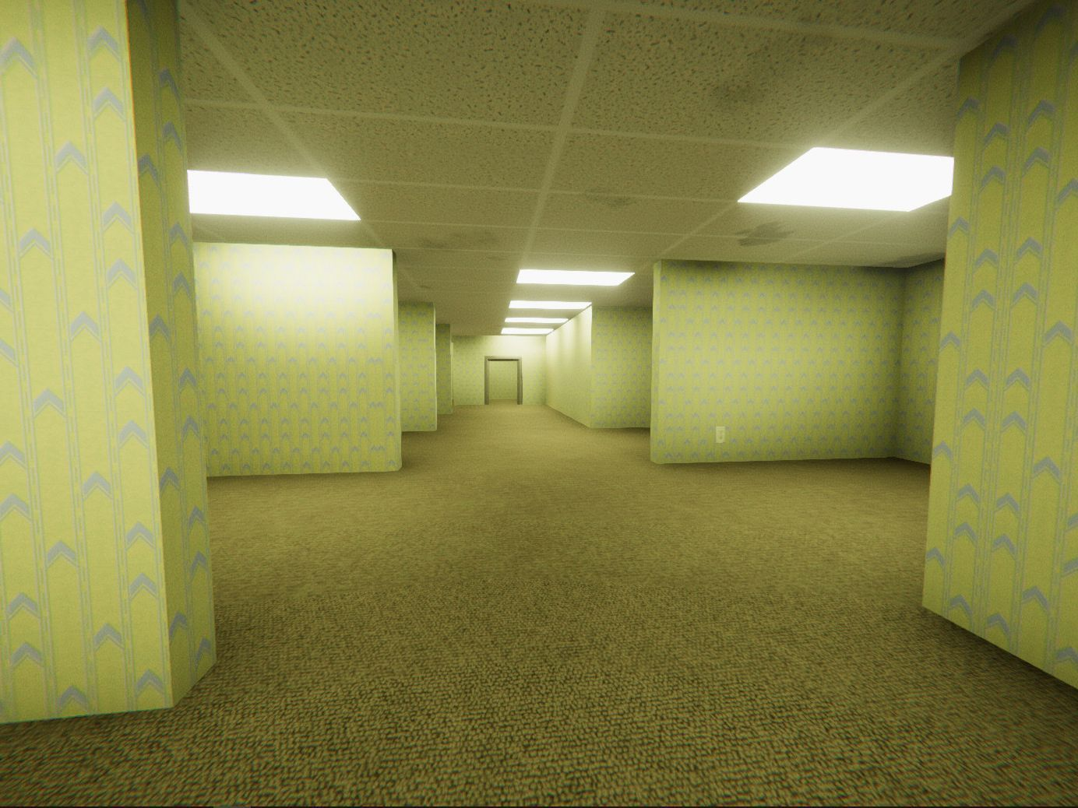
Irasc -
angry
Ire
Irascible
Irate
Notes:
Ech – sound
Ego – self
Eme – vomit
Endo – inside/within
Epi = upon
Erg – work
Ethn- race/people
Exo – outside
Fac – do or make
Fall – false
Fend – strike
-fer – bear or carry
Fides – truth trust
Fund - bottom

Slide 13
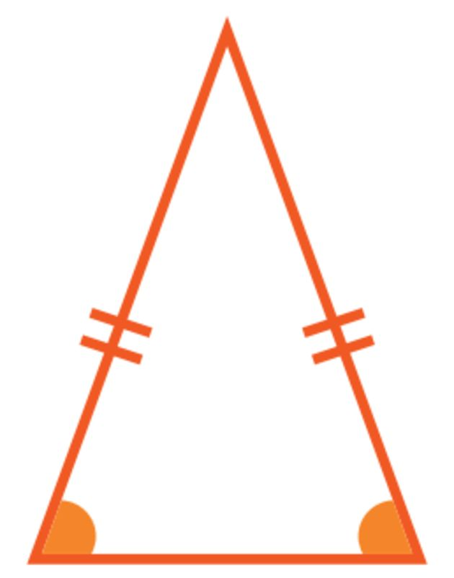
Iso -
Equal or same
Isosceles
Isotope
Isometric
Isotonic
Isothermal
Isobar
Notes:
Ech – sound
Ego – self
Eme – vomit
Endo – inside/within
Epi = upon
Erg – work
Ethn- race/people
Exo – outside
Fac – do or make
Fall – false
Fend – strike
-fer – bear or carry
Fides – truth trust
Fund - bottom

Slide 14
joc -
joke
Joke
Jocund
Jocularity
Jocular
Notes:
Ech – sound
Ego – self
Eme – vomit
Endo – inside/within
Epi = upon
Erg – work
Ethn- race/people
Exo – outside
Fac – do or make
Fall – false
Fend – strike
-fer – bear or carry
Fides – truth trust
Fund - bottom

Slide 15
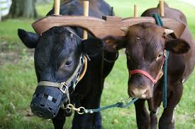
Jug/junct -
Yoke or join
Jugular
Conjunction
Junction
Juncture
Notes:
Ech – sound
Ego – self
Eme – vomit
Endo – inside/within
Epi = upon
Erg – work
Ethn- race/people
Exo – outside
Fac – do or make
Fall – false
Fend – strike
-fer – bear or carry
Fides – truth trust
Fund - bottom

Slide 16
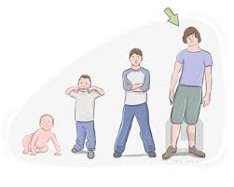
Juven-
Youth
Juvenile
Rejuvenate
Juvenescent
Juvenile
Notes:
Ech – sound
Ego – self
Eme – vomit
Endo – inside/within
Epi = upon
Erg – work
Ethn- race/people
Exo – outside
Fac – do or make
Fall – false
Fend – strike
-fer – bear or carry
Fides – truth trust
Fund - bottom

Slide 17
Juxta
Nearby or close
Juxtapose
Juxtaposition
Jostle
Notes:
Ech – sound
Ego – self
Eme – vomit
Endo – inside/within
Epi = upon
Erg – work
Ethn- race/people
Exo – outside
Fac – do or make
Fall – false
Fend – strike
-fer – bear or carry
Fides – truth trust
Fund - bottom

