Slide 1

Prefixes and Roots Beginning With M or N: Meanings and Word Examples
Enhancing vocabulary through understanding word origins
Notes:
---
This presentation explores common prefixes and roots starting with the letters M and N, their meanings, and examples of words that use them. Understanding these can enrich vocabulary and comprehension of English word formation.
Image source: Microsoft 365 content library

Slide 2

Agenda Items Overview
Prefixes Starting With M: Meanings and Word Examples
Roots Starting With M: Meanings and Word Examples
Prefixes Starting With N: Meanings and Word Examples
Roots Starting With N: Meanings and Word Examples
Notes:
---
We will cover prefixes starting with M, including macro-, micro-, and mono-. Then we will explore roots beginning with M, such as matri- and mort-. Next, we will examine prefixes starting with N, like neo- and non-. Finally, we will review roots beginning with N, including nav- and nom-.
Image source: Microsoft 365 content library

Slide 3
Prefixes and roots Starting With M: Meanings and Word Examples
Notes:
This section introduces several prefixes starting with the letter M. Each prefix has a distinct meaning and is used in many English words.

Slide 4
The Prefix 'Macro-' Meaning Large or Long
Meaning of 'Macro-'
The prefix 'macro-' signifies something large or long in size or scope.
Example: Macrocosm
'Macrocosm' refers to the large world or universe, showing the prefix application.
Example: Macroeconomics
'Macroeconomics' studies the economy as a whole, emphasizing broad economic factors.
Notes:
---
The prefix 'macro-' means large or long. It is often used in words like 'macrocosm' (the large world) and 'macroeconomics' (the study of the economy as a whole).
Image source: Microsoft 365 content library

Slide 5

The Root 'Matri-' Meaning Mother
Meaning of 'Matri-' Root
  The root 'matri-' signifies mother and is used in various English words.
Example: Matriarch
  'Matriarch' refers to a woman who leads a family or tribe, highlighting maternal leadership.
Example: Matrimony
  'Matrimony' means marriage, relating to the bond often associated with motherhood and family.
Notes:
---
The root 'matri-' means mother. It is found in words like 'matriarch' (a woman who leads a family or tribe) and 'matrimony' (marriage).
Image source: Microsoft 365 content library

Slide 6

The Prefix 'Micro-' Meaning Small
Meaning of Micro-
  The prefix 'micro-' denotes something that is very small or tiny in size.
Microscope Example
  A microscope is an instrument used to view very small objects that cannot be seen by the naked eye.
Microorganism Example
  Microorganisms are tiny living organisms like bacteria and viruses that can only be seen through a microscope.
Notes:
---
The prefix 'micro-' means small. Examples include 'microscope' (an instrument to see small objects) and 'microorganism' (a tiny living thing).
Image source: Microsoft 365 content library

Slide 7

The Prefix 'Mono-' Meaning One or Single
Meaning of Mono-
  The prefix 'mono-' means one or single, indicating singularity in words.
Monologue Example
  'Monologue' means a speech delivered by one person alone.
Monopoly Example
  'Monopoly' means exclusive control or ownership by one entity.
Notes:
---
The prefix 'mono-' means one or single. It appears in words like 'monologue' (a speech by one person) and 'monopoly' (exclusive control by one entity).
Image source: Microsoft 365 content library

Slide 8
The Root 'Mort-' Meaning Death
Meaning of 'Mort-' Root
The root 'mort-' signifies death or the state related to dying in various English words.
Example: Mortality
'Mortality' refers to the state of being subject to death or the condition of being mortal.
Example: Mortuary
'Mortuary' is a place designated for keeping dead bodies before burial or cremation.
Notes:
---
The root 'mort-' means death. Examples include 'mortality' (the state of being mortal) and 'mortuary' (a place where dead bodies are kept).
Image source: Microsoft 365 content library

Slide 9
Prefixes and roots Starting With N: Meanings and Word Examples
Notes:
This section presents prefixes starting with N, which modify the meanings of words in important ways.

Slide 10

The Root 'Nav-' Meaning Ship
Meaning of 'Nav-' Root
  The root 'nav-' signifies ship or sailing, commonly used in maritime-related words.
Example: Navigate
  'Navigate' means to plan and direct a ship's course across waters.
Example: Naval
  'Naval' pertains to navy forces and maritime military activities.
Notes:
---
The root 'nav-' means ship or sailing. It is found in words like 'navigate' (to plan and direct a ship's course) and 'naval' (relating to a navy).
Image source: Microsoft 365 content library

Slide 11
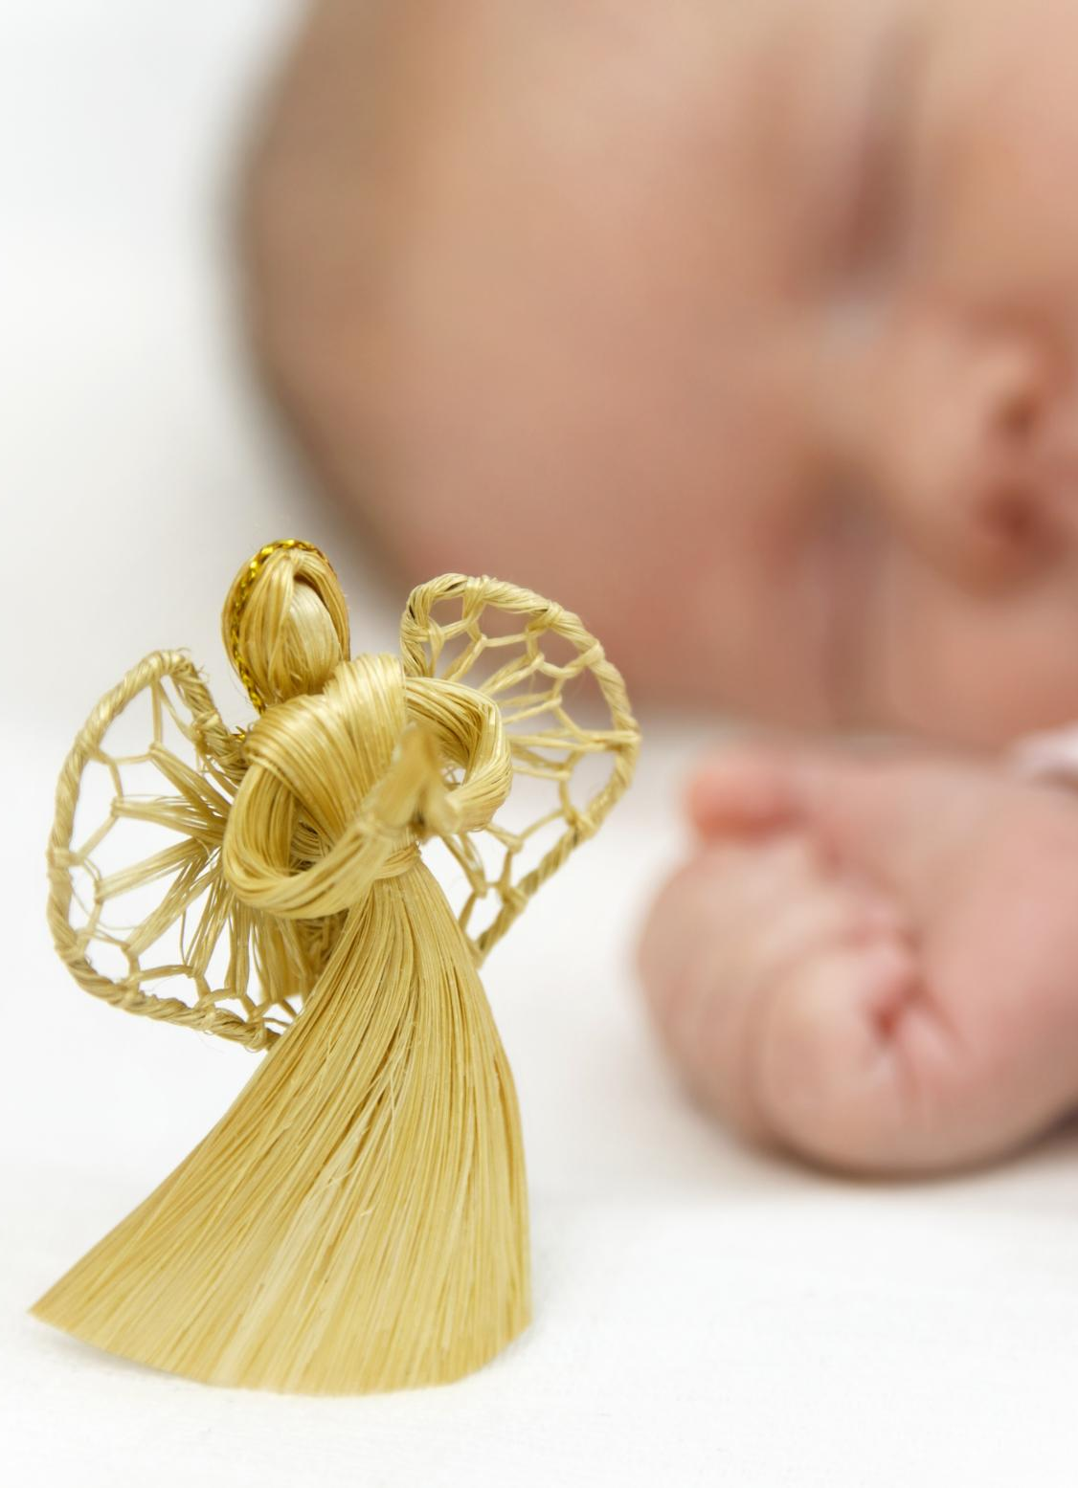
The Prefix 'Neo-' Meaning New
Meaning of 'Neo-' Prefix
  The prefix 'neo-' signifies something new or recent in origin or style.
Example: Neoclassical
  'Neoclassical' refers to a revival or new interpretation of classical styles in art and architecture.
Example: Neonatal
  'Neonatal' pertains to newborn babies, highlighting the concept of new life.
Notes:
---
The prefix 'neo-' means new or recent. Words like 'neoclassical' (a revival of classical style) and 'neonatal' (relating to newborns) use this prefix.
Image source: Microsoft 365 content library

Slide 12

The Root 'Nom-' Meaning Name or Law
Meaning of Root 'Nom-'
  The root 'nom-' signifies concepts related to name or law in English vocabulary.
Example: Nominate
  'Nominate' means to name someone for a position or role officially.
Example: Autonomy
  'Autonomy' means self-law or self-rule, indicating independence and self-governance.
Notes:
---
The root 'nom-' means name or law. Examples include 'nominate' (to name for a position) and 'autonomy' (self-law or self-rule).
Image source: Microsoft 365 content library

Slide 13
The Prefix 'Non-' Meaning Not
Meaning of 'Non-' Prefix
The prefix 'non-' means not or absence of something, altering the meaning of base words.
Example: Nonsense
'Nonsense' means speech or ideas that have no meaning or make no sense.
Example: Nonprofit
'Nonprofit' refers to organizations that do not operate for profit but for a cause.
Notes:
---
The prefix 'non-' means not or absence of. It appears in words such as 'nonsense' (meaningless speech) and 'nonprofit' (not for profit).
Image source: Microsoft 365 content library

